Slide 1
Final Project Discussion

Slide 2

Intro to Open Science

Slide 3
What is Open Science?
No one definition
Practices that increase transparency and accessibility of research

Slide 4
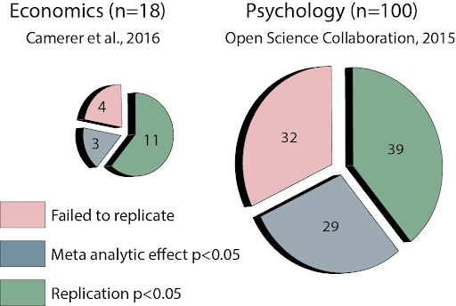
Why Open Science?
Concerned about credibility of psychology studies
  Why?
    Fabrication (small subset)
    Failure to replicate
    Type I errors
    Small Sample Sizes
    Generalizability
    Questionable Research Practices

Slide 5
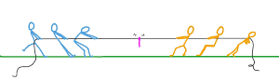
What Leads to questionable Research Practices?
Journals
  Want to only publish cool/interesting things
  Don’t want to publish null results (no finding)
    BORING
Researchers
  Want to publish
  Helps them get to the next step (grad school, post doc, professor, tenure)

Slide 6
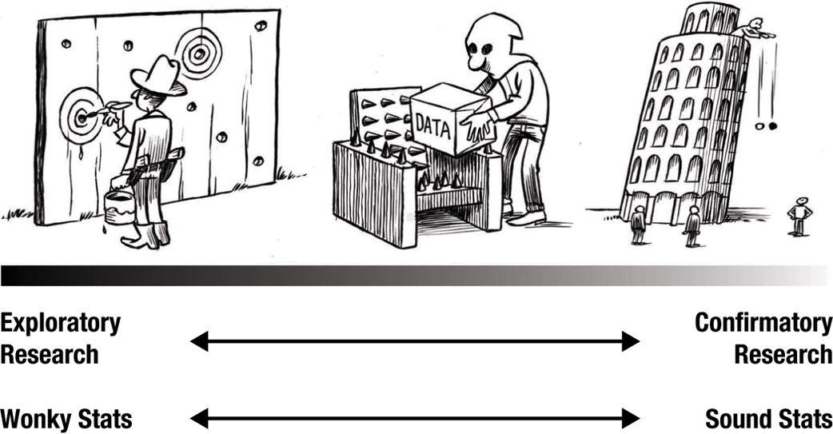
What are questionable research practices? #2
Not differentiating between Exploratory vs Confirmatory Research
  Exploratory - No Theory
  Confirmatory - Theory Driven
  Both are ok- need to identify which one

Slide 7
What Are Questionable Research Practices? #3
P= 0.03
P= 0.055
P= 0.06
P= 0.96

Slide 8
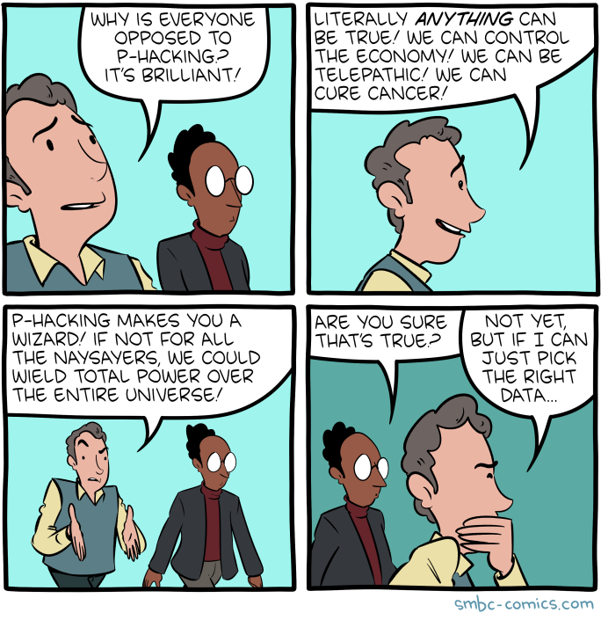

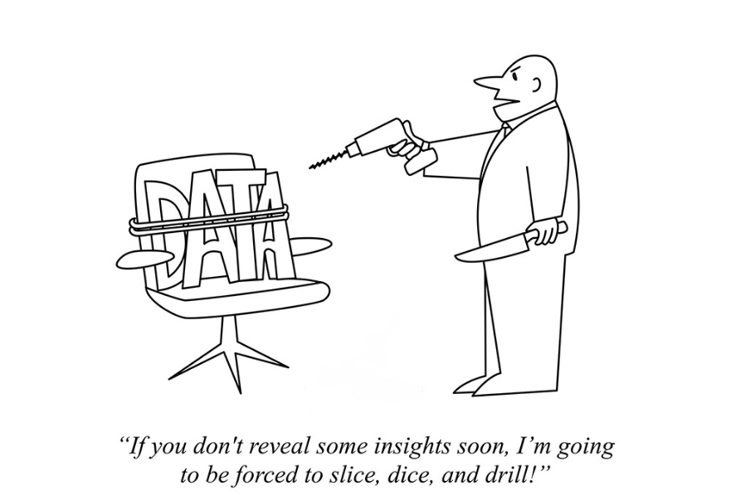
What Are Questionable Research Practices? #4
P hacking
HARKing

Slide 9

Factors Related to Open Science
Transparent Research
  Can I figure out what you did?
Reproducibility
  Can I redo *exactly* what you did with your data?
Replicability
  Do I get the same results if I redo your study?

Slide 10

Components of Open Science
Preregistration

Slide 11

Components of Open Science #2
Data and Code Sharing

Slide 12

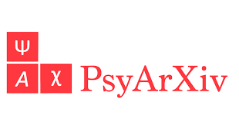
Components of Open Science #3
Open Access

Slide 13
Introduction to GitHub
Dr. Amanda Woodward

Slide 14
Learning Outcomes #2
By the end of this class, students should be able to:
    Explain what Github is and how it relates to open science
    Identify common actions in Github and explain what they mean
    Articulate how Github can be integrated with R/R Studio
    Apply these concepts to work on Github files

Slide 15
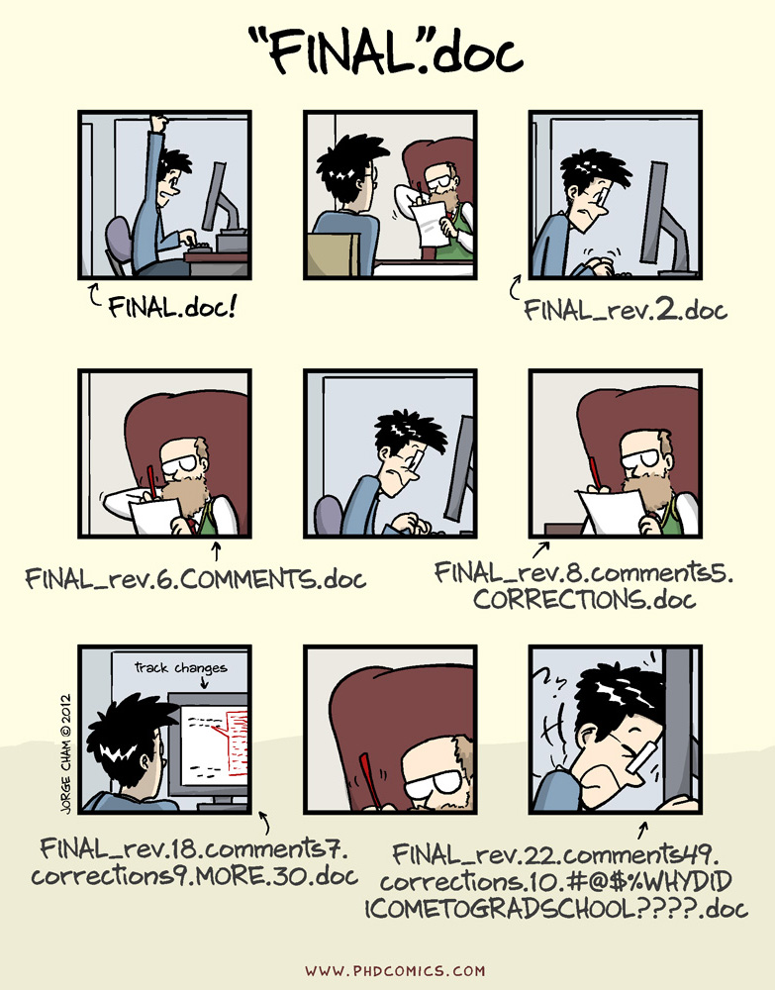

What is GitHub?
Hosting service to help with version control

Slide 16
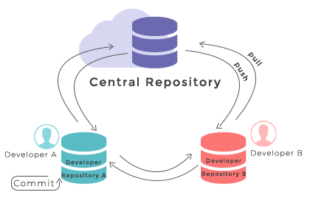
What is GitHub? #2
Hosting service to help with version control
Repository (storage)
    Store code on cloud
    Free options
Multiple people can work on same project

Slide 17

Why GitHub?
FREE! (at least some options)
Facilitates cooperation among researchers
    Easy to share code
    Easy to collaborate
    Facilitate open source projects
    Open source
        Freely available, modifiable

Slide 18
GitHub- Activity
Part of learning is figuring out *exactly* what exists
For this activity, we’ll examine github pages
  https://github.com/weeeBox
  https://github.com/djnavarro
  https://github.com/neuropsychology
  https://github.com/mdsteiner
What do you notice about these github pages?
  What elements of Open Science are apparent?
  How does this increase collaboration?
  What questions do you have?

Slide 19
Learning Outcomes
By the end of this class, students should be able to:
    Explain what Github is and how it relates to open science
    Identify common actions in Github and explain what they mean
    Articulate how Github can be integrated with R/R Studio
    Apply these concepts to work on Github files

Slide 20
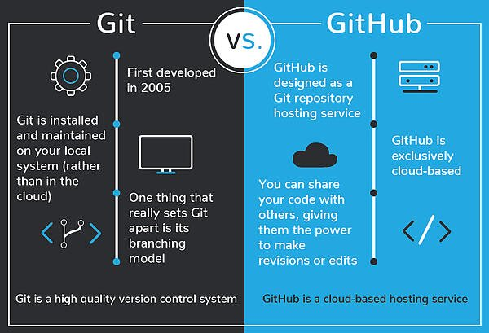
Git versus Github

Slide 21
Common GitHub Actions (Vourre & Curley, 2018)
Git repository: contents tracked by Git. Changes in this folder can be saved to Git’s history. Located on users’ computers (local repositories)
GitHub repository: a repository hosted on GitHub. Can be set receive changes from local repositories (remote or central repository)
Initialize a local repository: creates a local Git repository on a computer
Clone a remote repository: creates a local Git repository by copying a remote repository (e.g., one hosted on GitHub).

Slide 22
Common GitHub Actions #2 (Vourre & Curley, 2018)
Commit changes: creates a snapshot of the project’s current state by saving changes to Git’s history.
    A commit can include a short message describing the commit’s purpose.
  Git history: a list of all the commits made in the repository.
  Checkout: switch to an earlier version of the project
  Push committed changes: sends changes made on a user’s local repository to the central (remote) repository.
  Pull changes: brings changes from the central (remote) repository to a user’s local repository, to keep it up-to-date with other collaborators’ changes.

Slide 23
How are we feeling?

